Slide 1
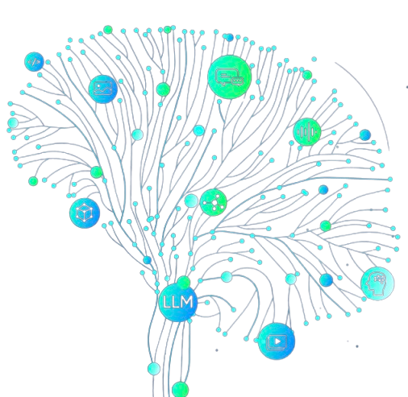
Experimental Approach for Fine-Tuning GPT-4 for Ontology Engineering
Leveraging Semantic Web Knowledge from Core Texts

Slide 2
Fine-tuning GPT-4 for OE
Research Objective
Goal
Key Focus
Develop a fine-tuned GPT-4 model for ontology engineering by generating and curating semantic knowledge using selected foundational texts.
Translation of knowledge from books into structured questions-answers (Q&A) aligned with ontology engineering needs.

Slide 3
Data Preparation Workflow
Selection of Foundational Texts
Semantic Web for Working Ontologist | Dean Allemang & Jim Hendler
A Semantic Web Primer | Grigoris Antoniou, Paul Groth, Frank Van Harmelen, & Rinke Hoekstra.
An Introduction to Ontology Engineering | Maria Keet
These texts comprehensively cover ontology engineering concepts and methodologies.

Slide 4
Segmentation of Textual Content
Splitting Books into manageable units
Each book was divided into chapters, typically 20–30 pages.
Average per chapter: ~60 messages.
Assumption: Each page generates 3–4 Q&A pairs.
Challenge: GPT-4's processing limitations necessitated smaller units.

Slide 5
Generating JSONL data
Prompt engineering and Q&A generation
Content Request
Generate 67 Q&A pairs covering all knowledge in a chapter
Batching
Limited to 15 Q&A pairs per iteration to ensure smooth processing
Incorporation of Visuals
Translate diagrams, schemes, and images into description logic
Example prompt
“I want in total 60 questions-answers. Give me now the first 20 messages-answers (big-full responsive answers where is needed) and remember when is necessary translate the visual content into descriptive text. You will continue to produce the rest of the messages-answers, after this prompt, so remember to give them in order of the chapter flow and not rearranged. Remember also you have to include all the knowledge on the pages and represent it in the queries.”

Slide 6
Iterative review and refinement
Curation of Generated Content
Post-generation review:
Check the relevance and alignment of Q&A pairs with ontology engineering goals.
Remove generic or irrelevant question (e.g. Summarize the chapter 6 and give the key points of it”).
2. Refinement:
Ensure questions explore ontology-related semantics, such as:
Classes, relations, and properties
RDF, OWL, SPARQL concepts
Application of visual elements in description logic

Slide 7
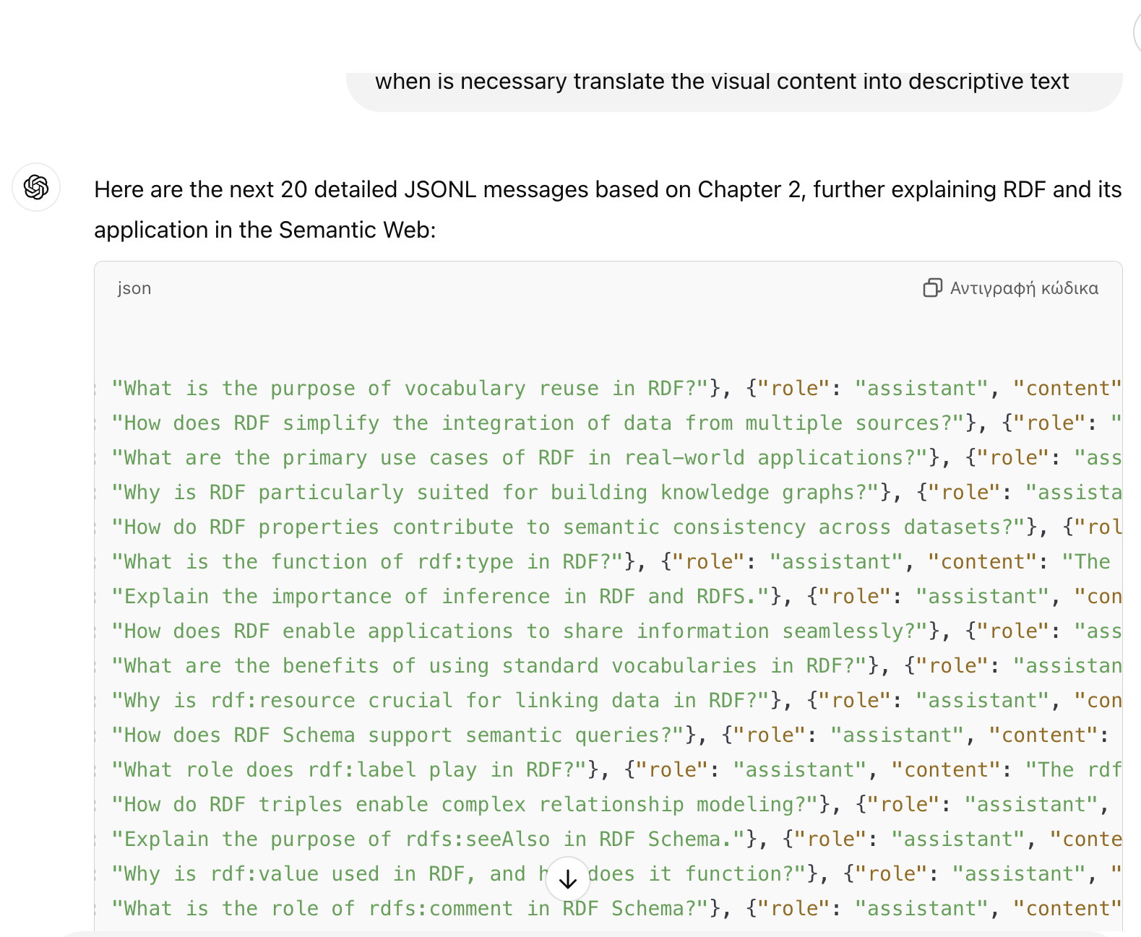
JSONL File Creation
Compiling Curated Q&A pairs
File structure
Outcome: Structured dataset for
fine-tuning GPT-4

Slide 8
Challenges Encountered
Translating visuals into text
GPT-4 stopping prematurely during Q&A generation
Approach: Manual verification of generated description logic
Solution: Limited prompts to smaller batches (15 pairs)

Slide 9
Experimental Approach Summary
Select foundational texts
based on relevance to ontology engineering
Segment chapters
Compile JSONL datasets
into smaller units for efficient processing
for fine-tuning
Generate Q&A pairs
Refine content
in JSONL format, using tailored prompts with iterative adjustments
by removing irrelevant or generic questions

Slide 10
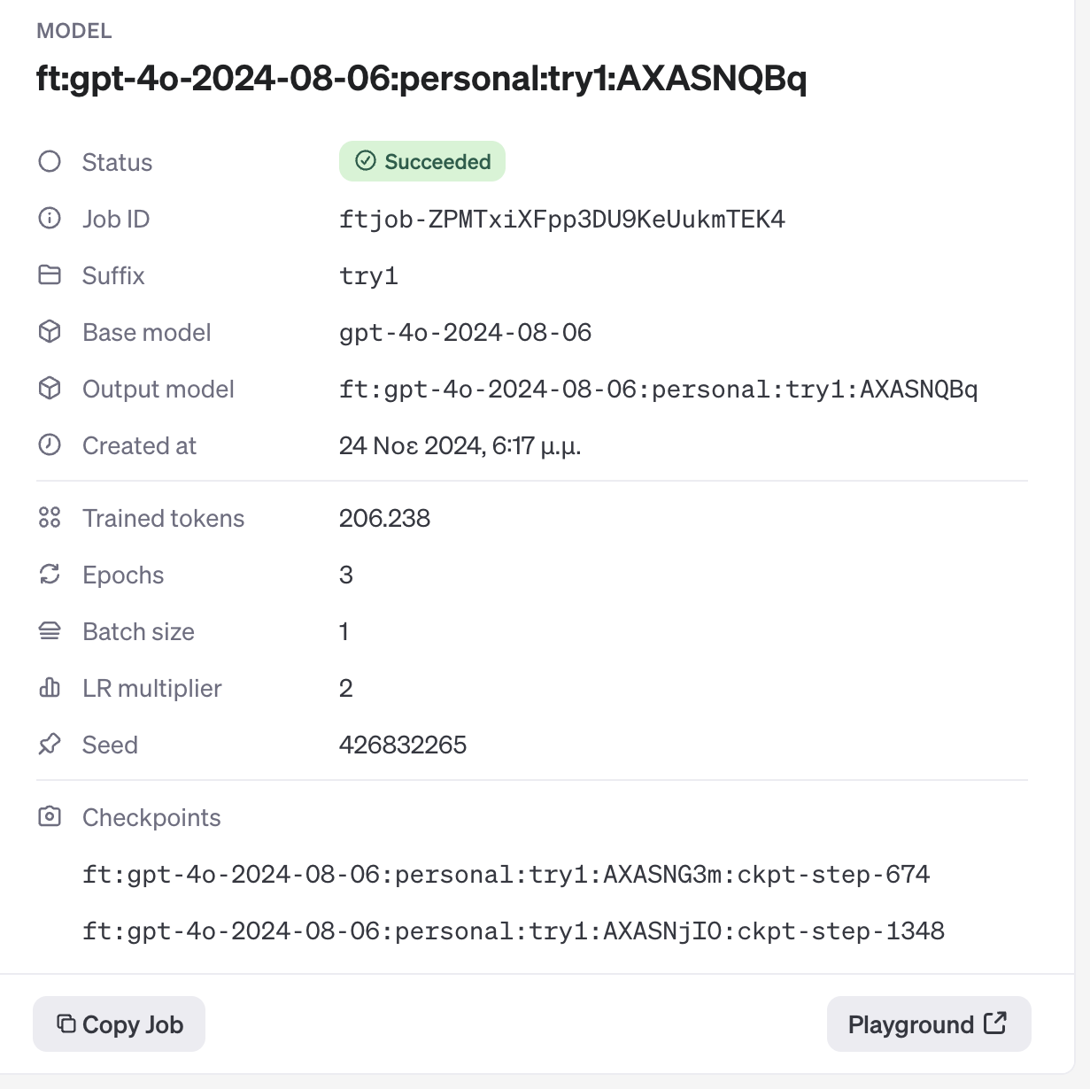
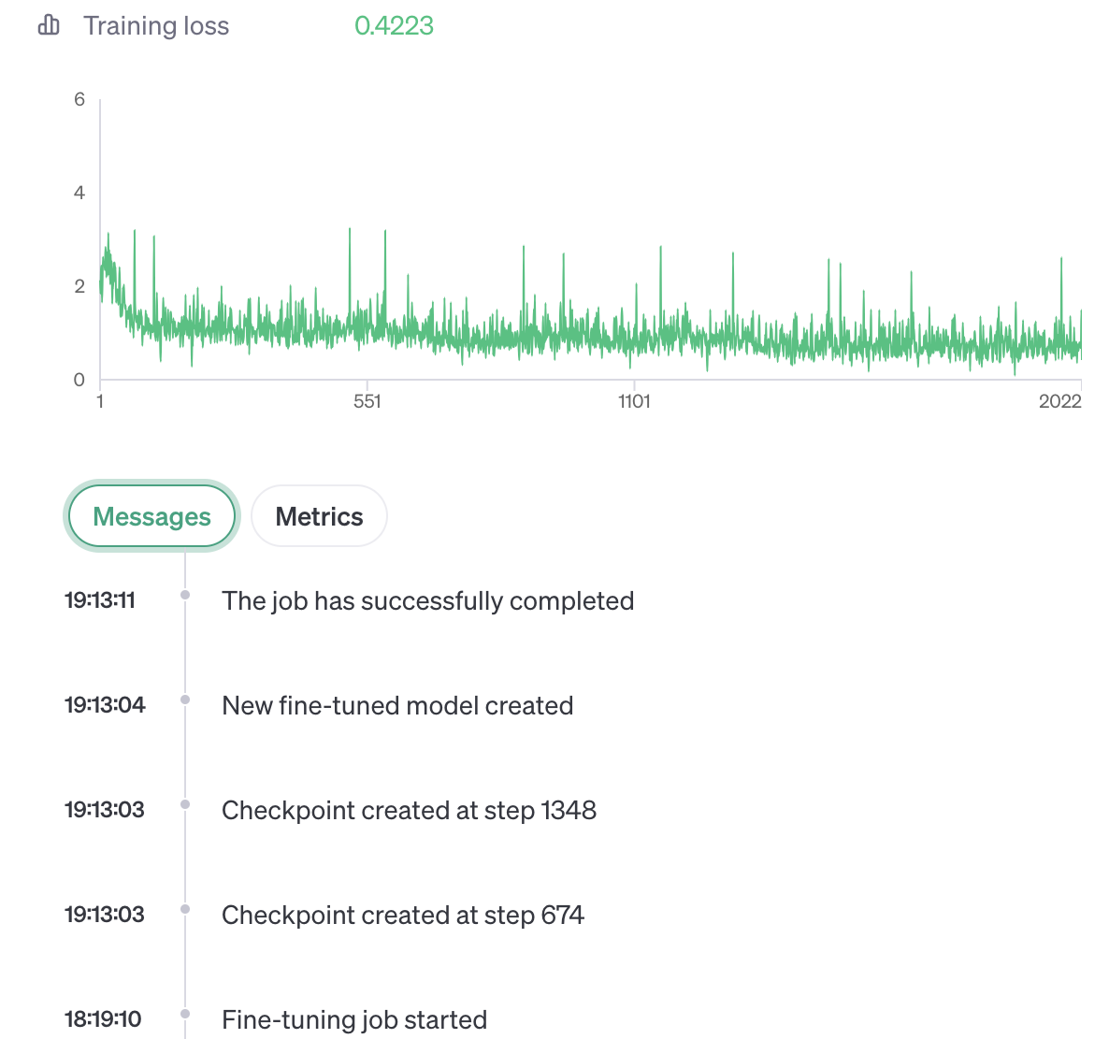
1st fine-tuning on GPT-4
First book: Semantic Web for Working Ontologist
One Prompt

Slide 11
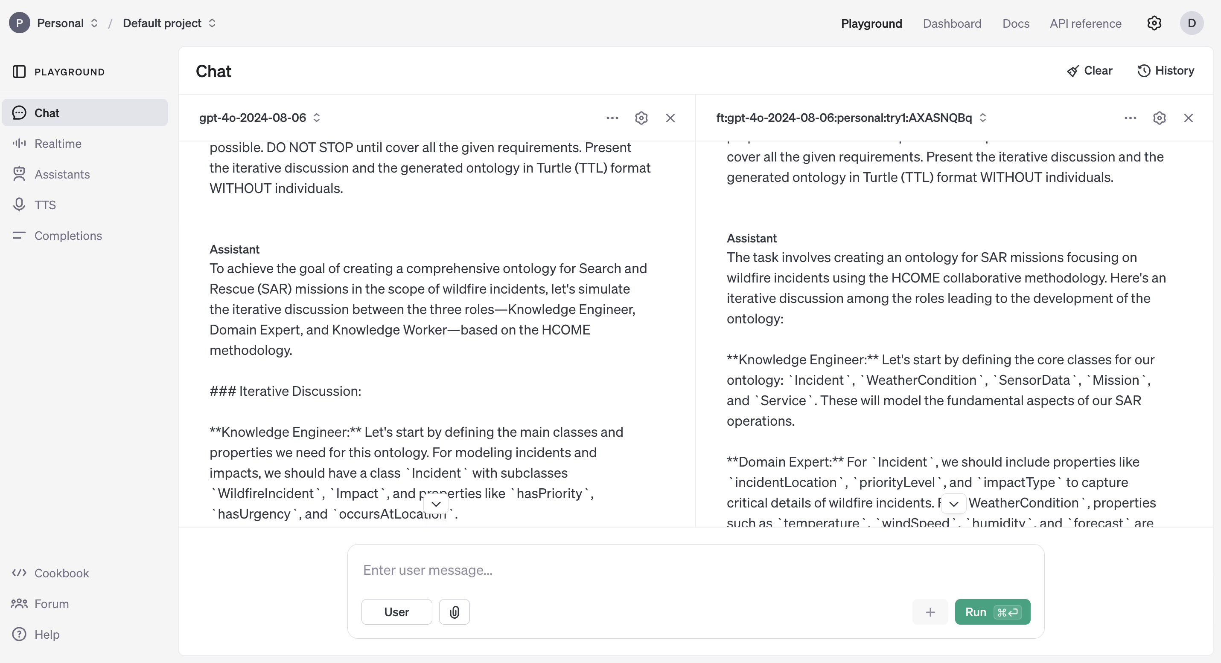
1st fine-tuning on GPT-4

Slide 12
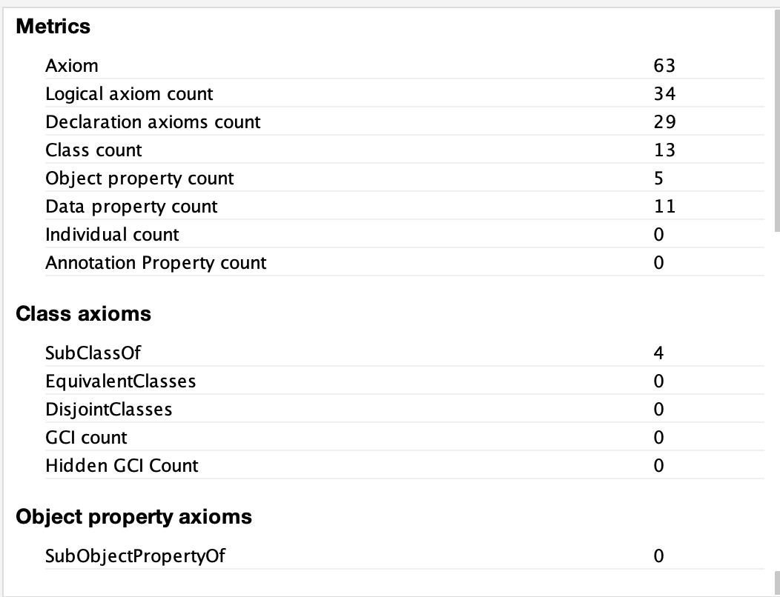
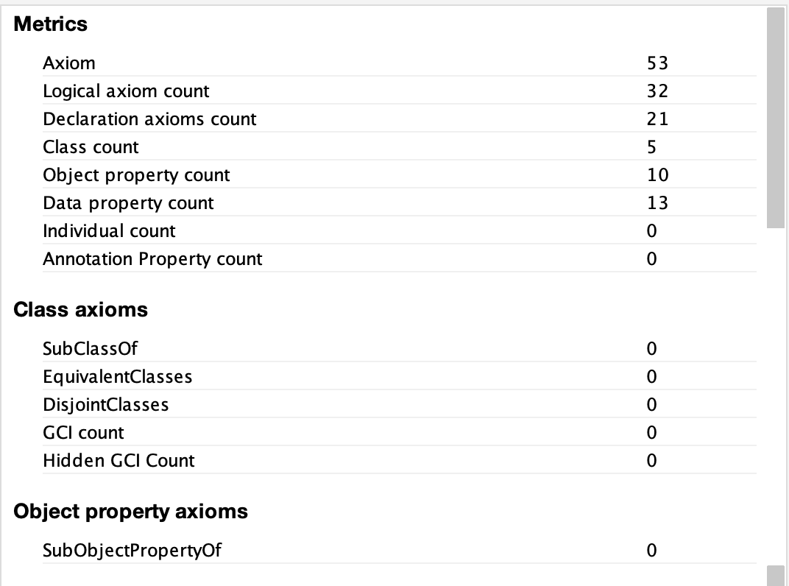
1st fine-tuning on GPT-4
Basic GPT4
Fine-tuned
GPT4

Slide 13
1st fine-tuning on GPT-4
METHOD | Number of Classes | True Positive | False Positives | False negatives | PRECISION | RECALL | F-1 SCORE
Reference | 80
GPT-4 Basic Model | 13 | 9 | 4 | 71 | 69% | 11,25% | 0,1935
GPT-4 Fine-tuned Model | 5 | 4 | 1 | 76 | 80% | 5% | 0,0941
METHOD | Number of Obj. properties | True Positive | False Positives | False negatives | PRECISION | RECALL | F-1 SCORE
Reference | 60
GPT-4 Basic Model | 5 | 0 | 5 | 60 | 0% | 0% | 0
GPT-4 Fine-tuned Model | 10 | 3 | 7 | 57 | 30% | 5% | 0,0857

Slide 14
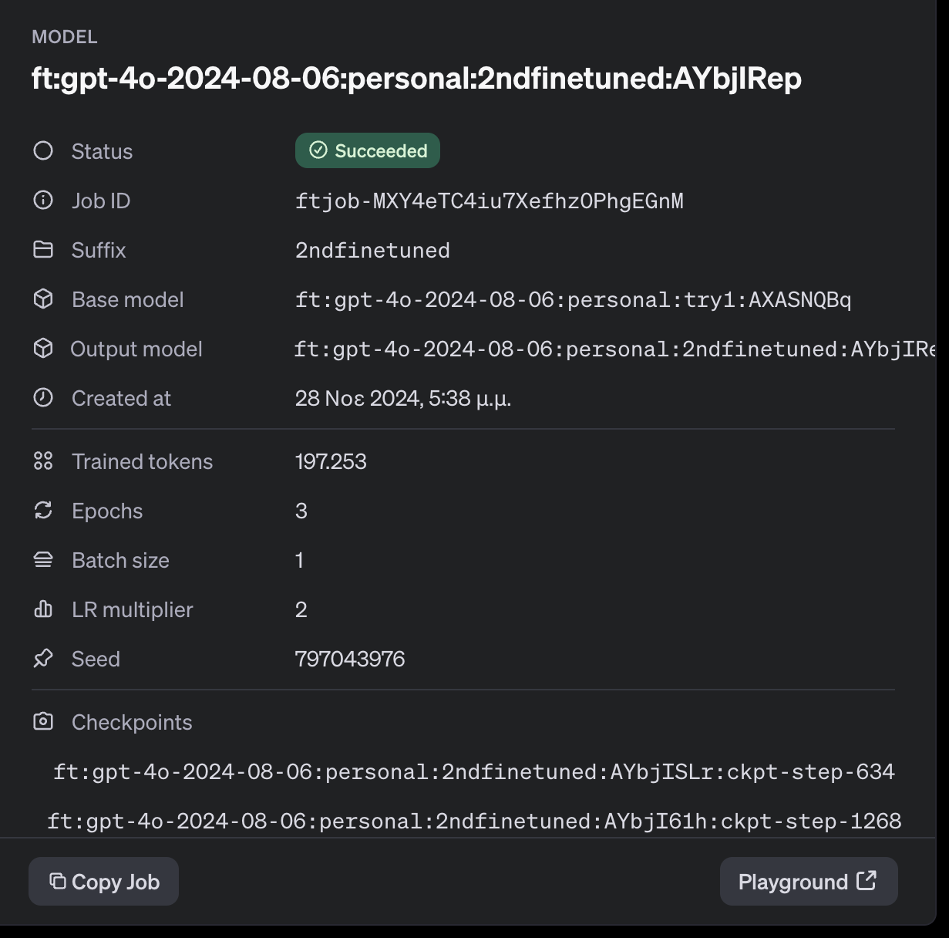
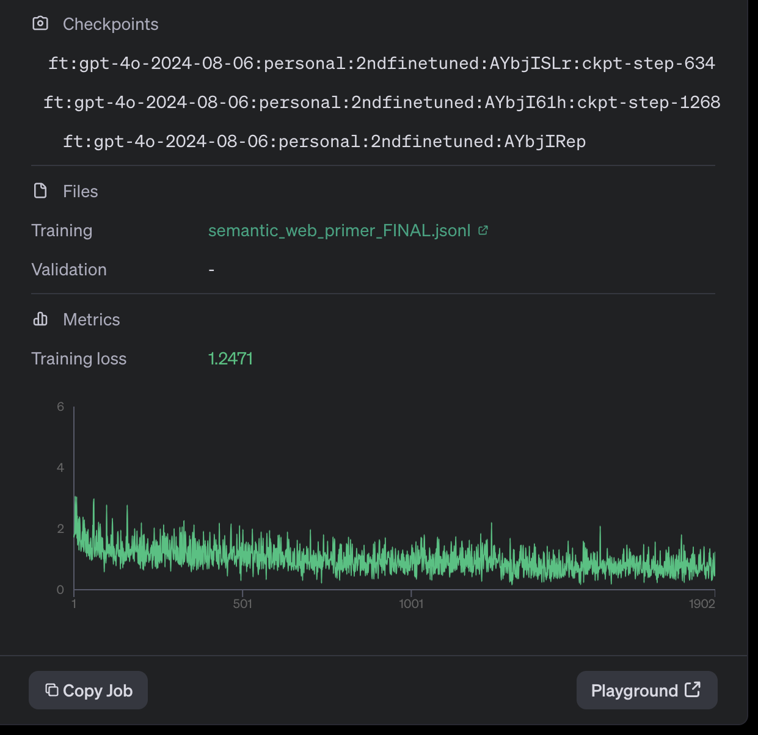
2st fine-tuning on GPT-4
First book:A Semantic Web Primer
One Prompt

Slide 15
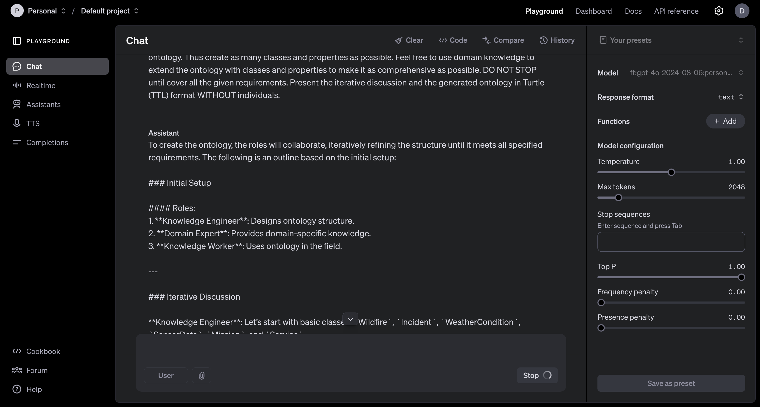
2st fine-tuning on GPT-4

Slide 16
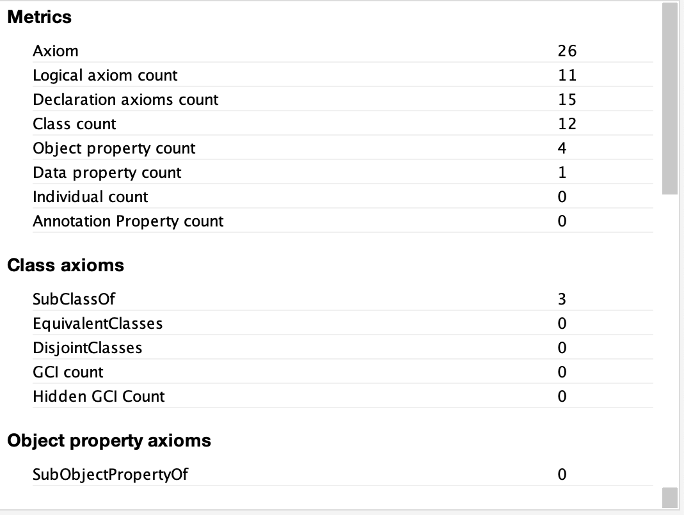
2st fine-tuning on GPT-4
Basic GPT4
Fine-tuned
GPT4

Slide 17
2st fine-tuning on GPT-4
METHOD | Number of Classes | True Positive | False Positives | False negatives | PRECISION | RECALL | F-1 SCORE
Reference | 80
GPT-4 Basic Model | 13 | 9 | 4 | 71 | 69% | 11,25% | 0,1935
GPT-4 Fine-tuned Model | 12 | 10 | 2 | 70 | 83% | 12,5% | 0,2173
METHOD | Number of Obj. properties | True Positive | False Positives | False negatives | PRECISION | RECALL | F-1 SCORE
Reference | 60
GPT-4 Basic Model | 5 | 0 | 5 | 60 | 0% | 0% | 0
GPT-4 Fine-tuned Model | 4 | 1 | 3 | 59 | 25% | 1,66% | 0,0312

Slide 18
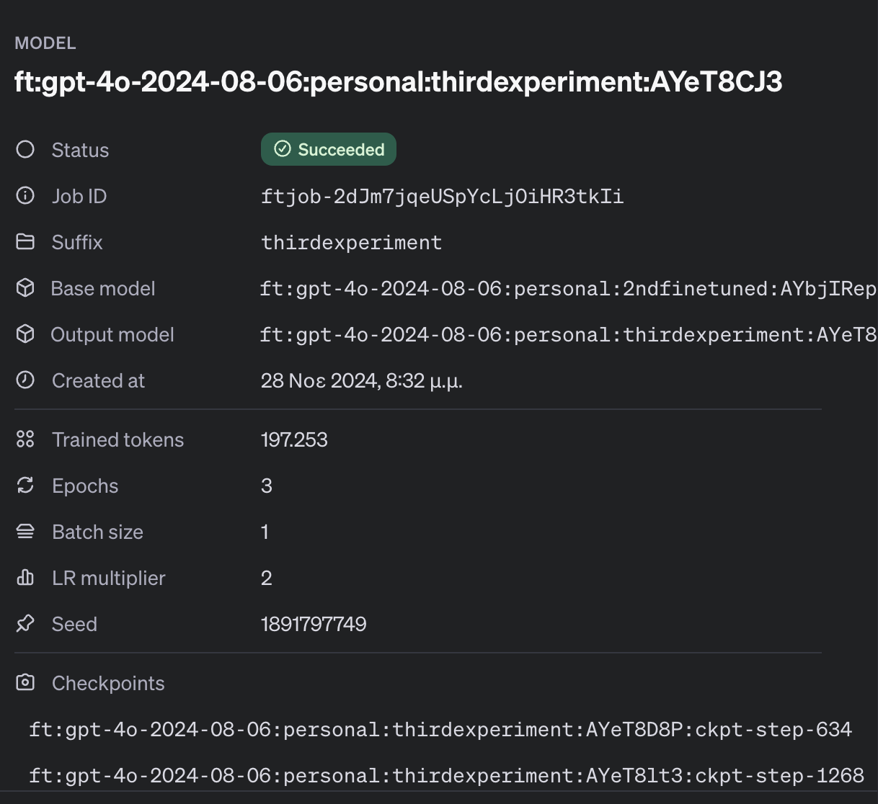
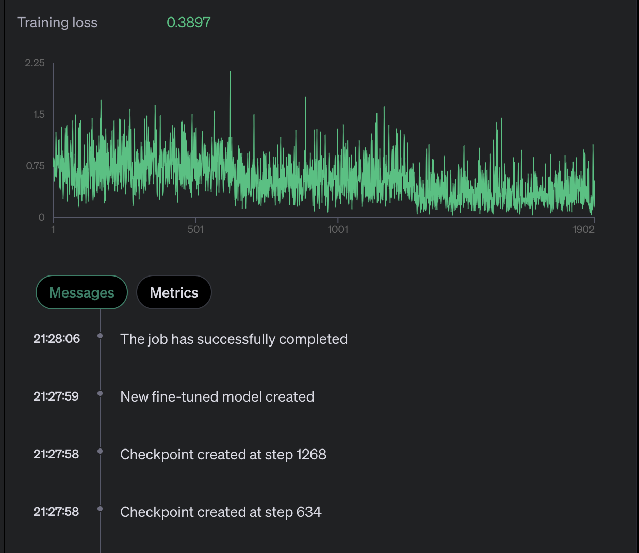
3st fine-tuning on GPT-4
First book: Ontology Engineering – Maria Keet
One Prompt
Produced the ontology, didn’t give any conversation with the 3 roles.

Slide 19
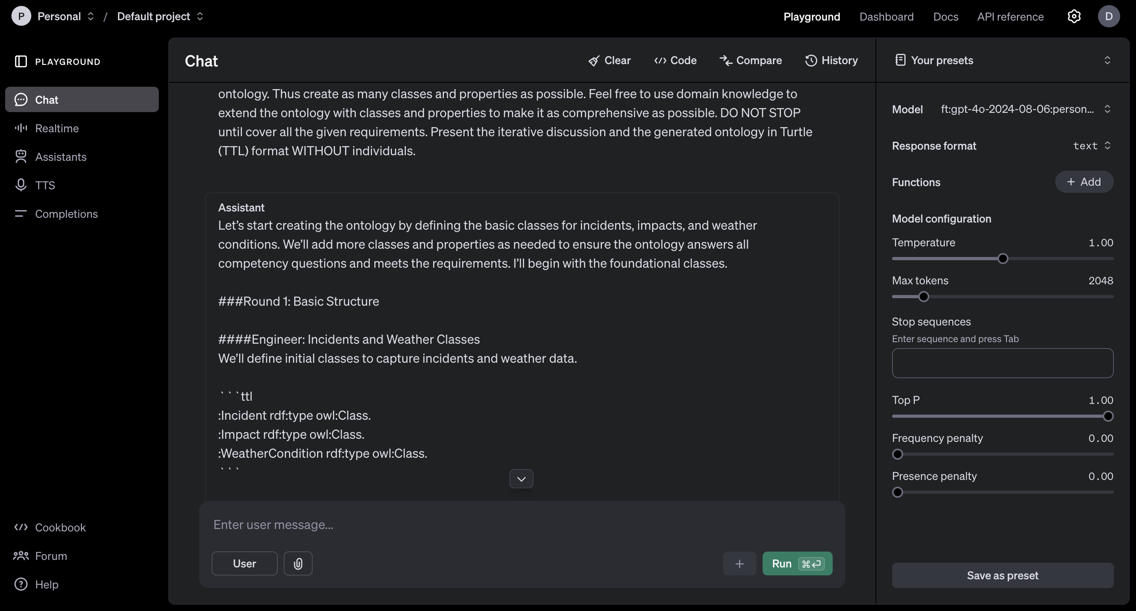
3st fine-tuning on GPT-4

Slide 20
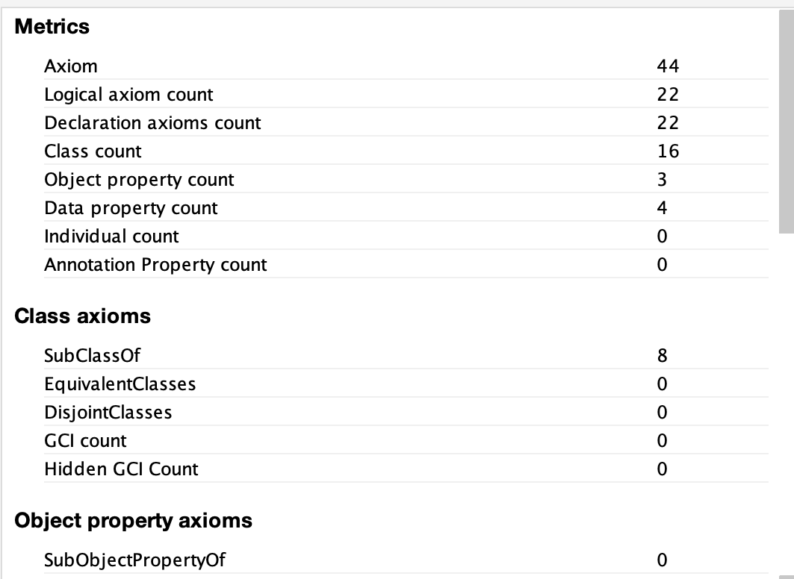
3st fine-tuning on GPT-4
Basic GPT4
Fine-tuned
GPT4

Slide 21
3st fine-tuning on GPT-4
METHOD | Number of Classes | True Positive | False Positives | False negatives | PRECISION | RECALL | F-1 SCORE
Reference | 80
GPT-4 Basic Model | 13 | 9 | 4 | 71 | 69% | 11,25% | 0,1935
GPT-4 Fine-tuned Model | 16 | 13 | 3 | 67 | 81,25% | 16,25% | 0,2708
METHOD | Number of Obj. properties | True Positive | False Positives | False negatives | PRECISION | RECALL | F-1 SCORE
Reference | 60
GPT-4 Basic Model | 5 | 0 | 5 | 60 | 0% | 0% | 0
GPT-4 Fine-tuned Model | 3 | 2 | 1 | 58 | 66,6% | 3,33% | 0,0634

Slide 22
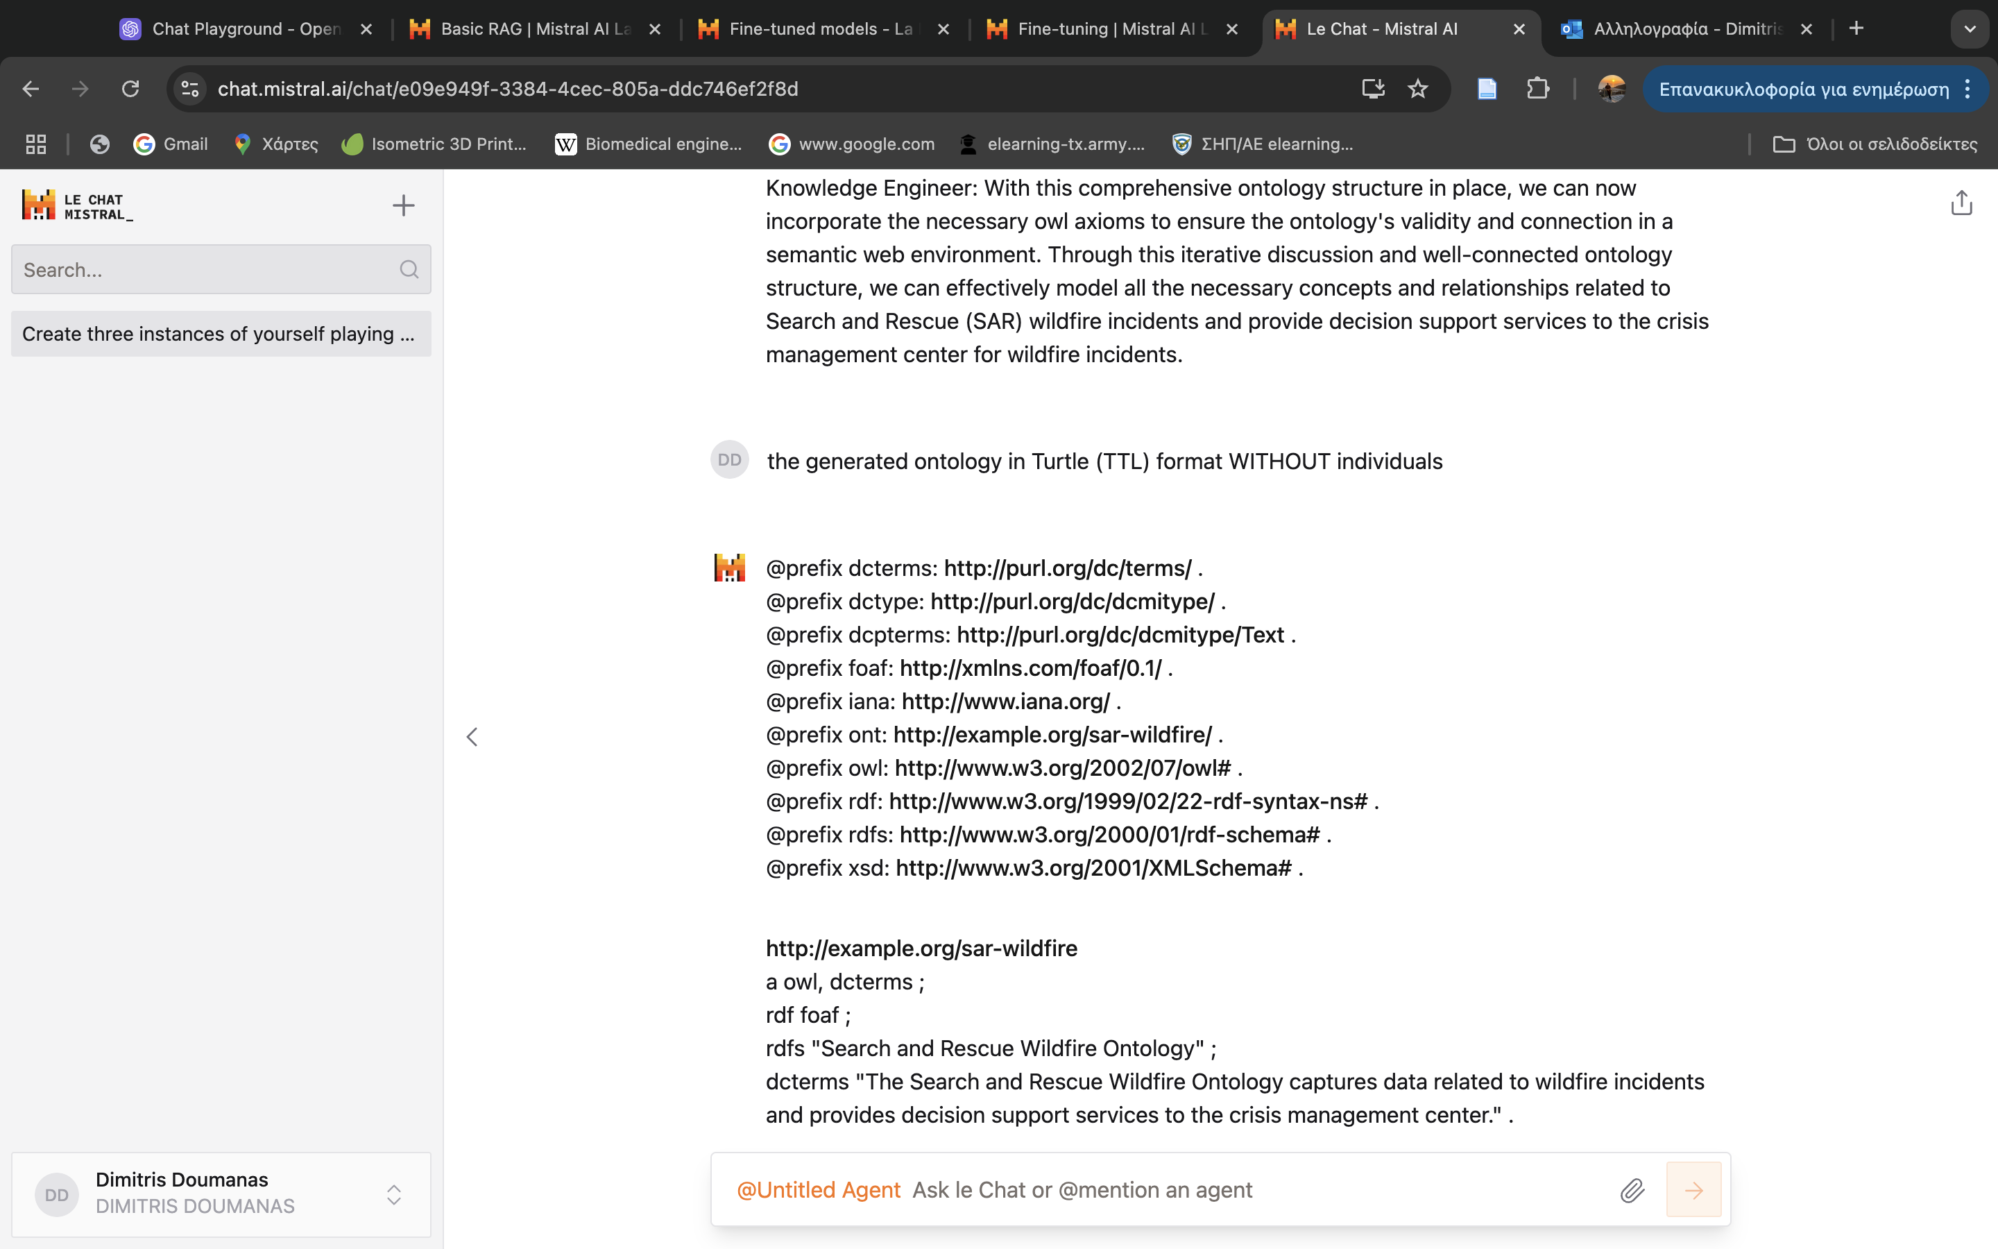
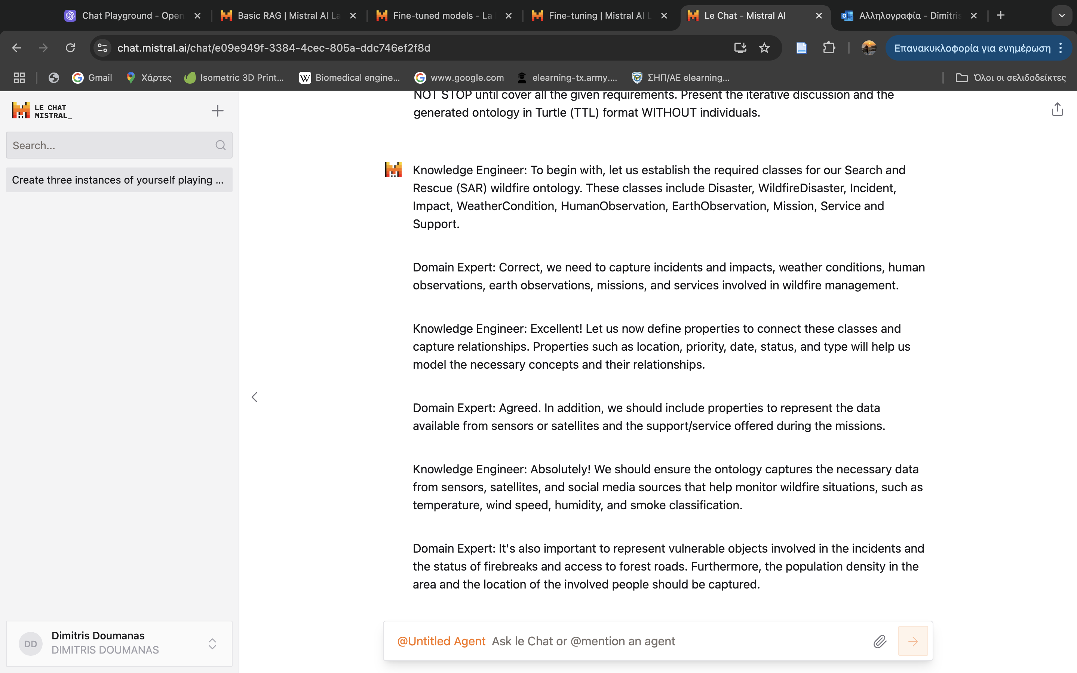
1st fine-tuning on Mistral
First book: Semantic Web for Working Ontologist
One Prompt
Generated the ontology after repeating prompting even if it was included in the first prompt
Basic GPT4
Fine-tuned
GPT4

Slide 23
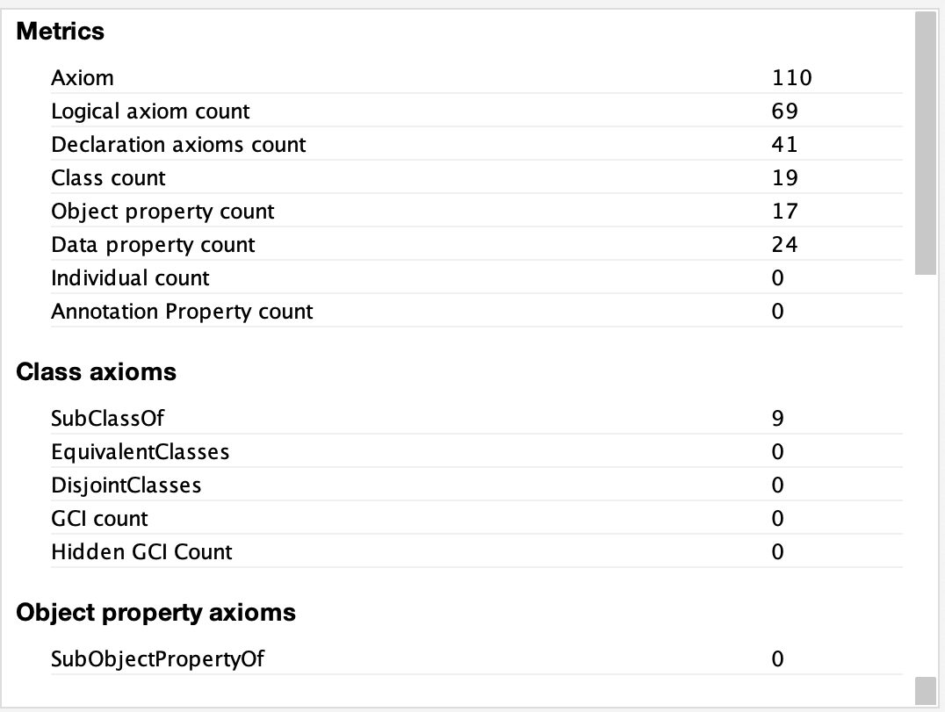
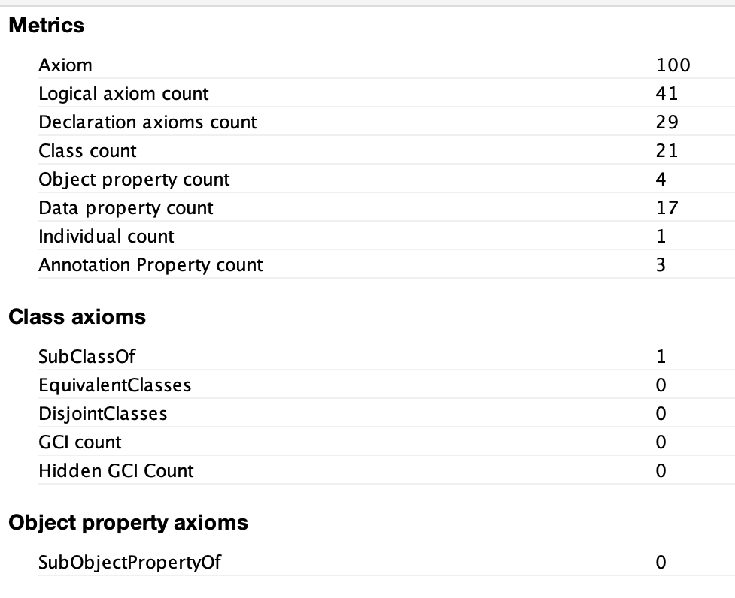
1st fine-tuning on Mistral
Basic Mistral
Fine-tuned
Mistral

Slide 24
1st fine-tuning on Mistral
METHOD | Number of Classes | True Positive | False Positives | False negatives | PRECISION | RECALL | F-1 SCORE
Reference | 80
Mistral Basic Model | 19 | 14 | 6 | 67 | 68,4% | 15,25% | 0,2626
Mistral Fine-tuned Model | 21 | 3 | 18 | 77 | 14,2% | 3,75% | 0,0594
16 of them are double
METHOD | Number of Obj. properties | True Positive | False Positives | False negatives | PRECISION | RECALL | F-1 SCORE
Reference | 60
Mistral Basic Model | 17 | 4 | 13 | 56 | 23,5% | 6,66% | 0,1038
Mistral Fine-tuned Model | 4 | 0 | 4 | 60 | 0% | 0% | 0

Slide 25
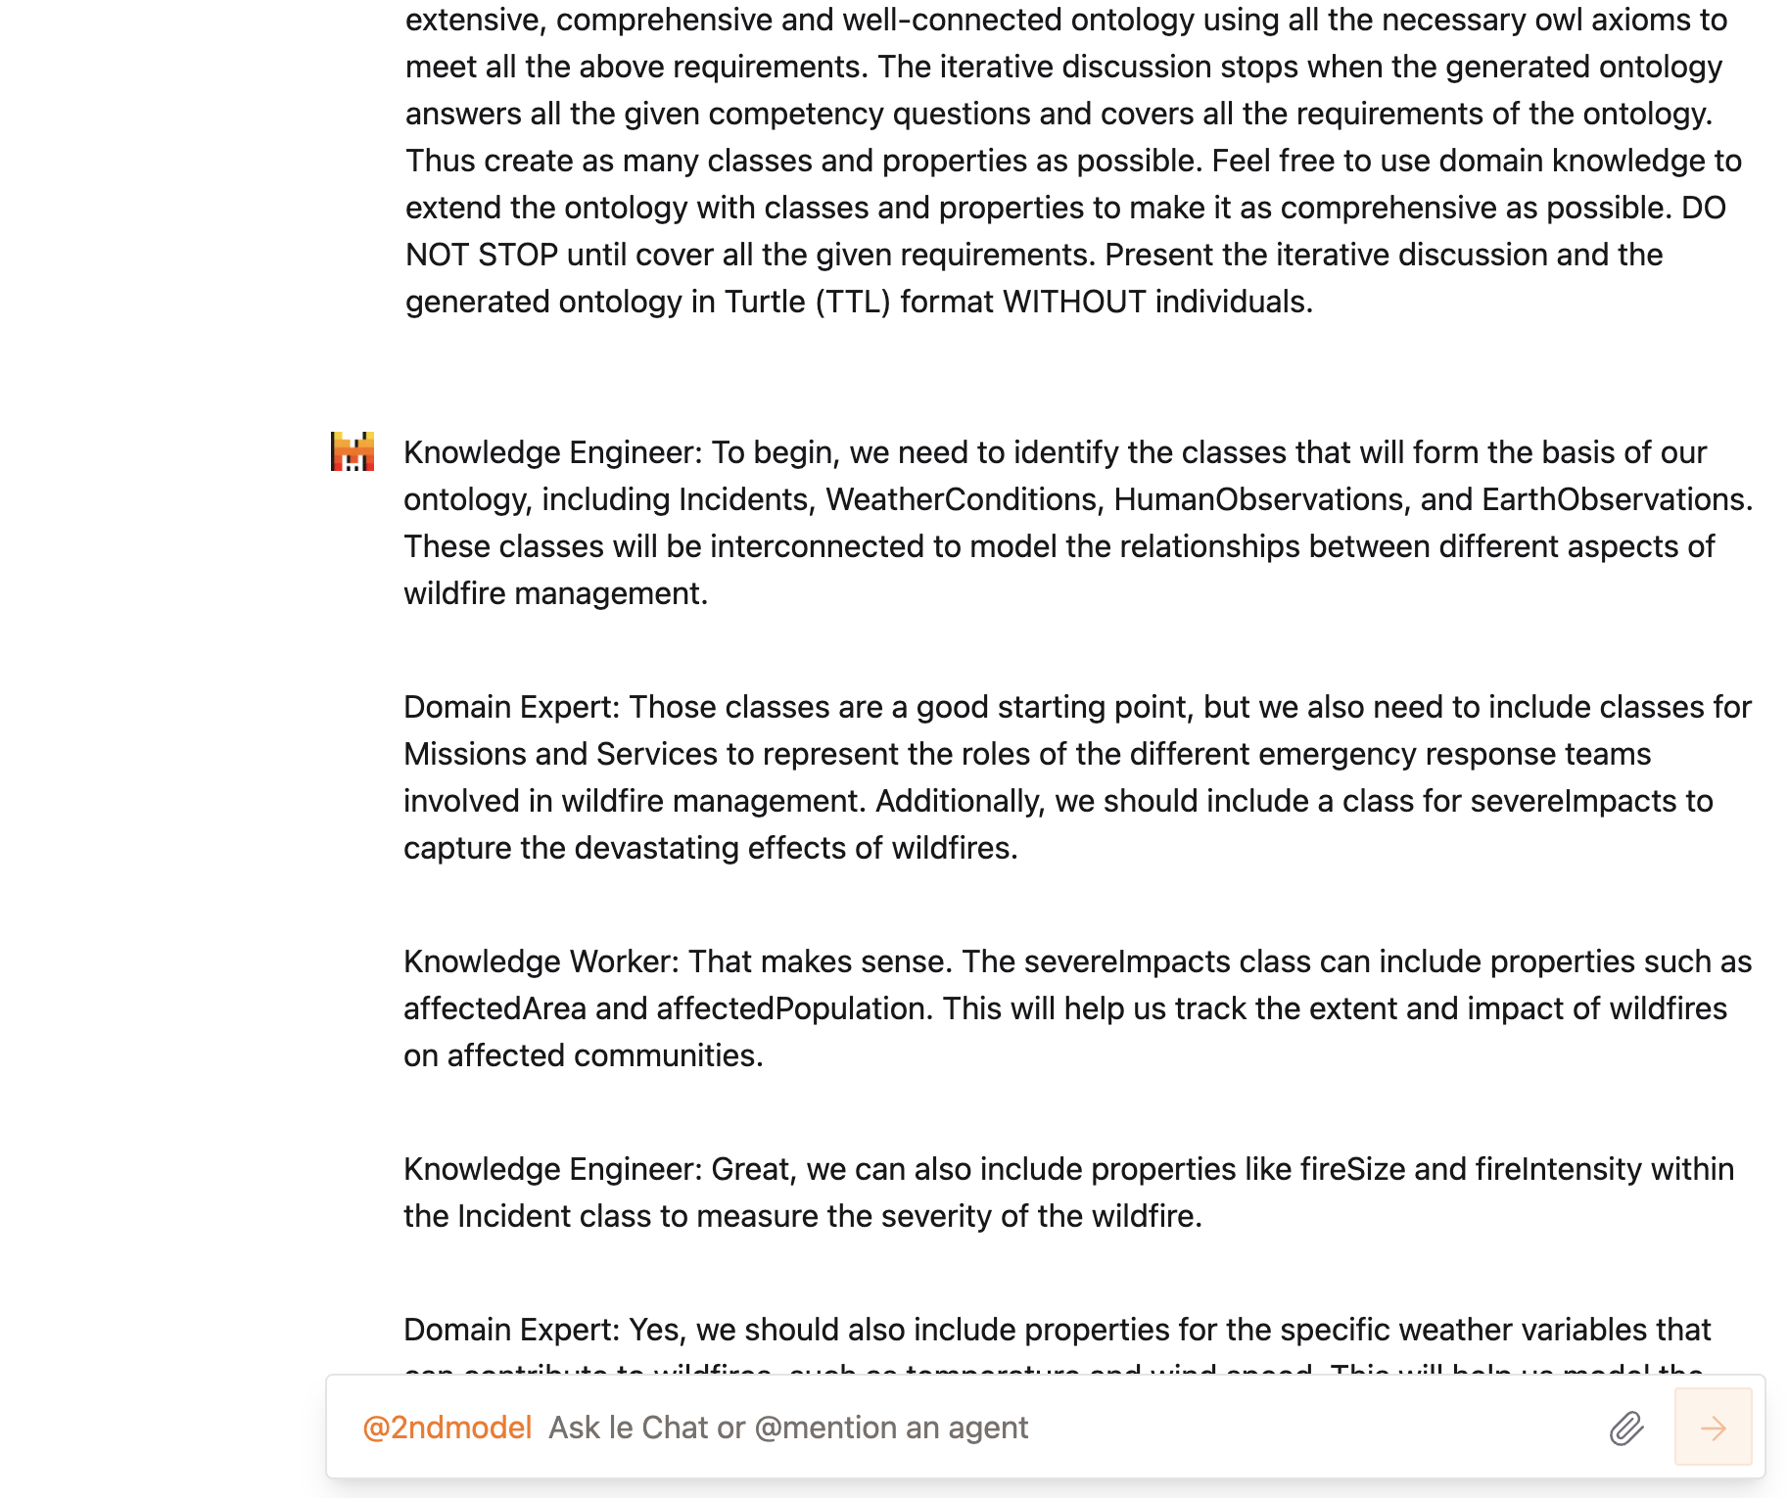
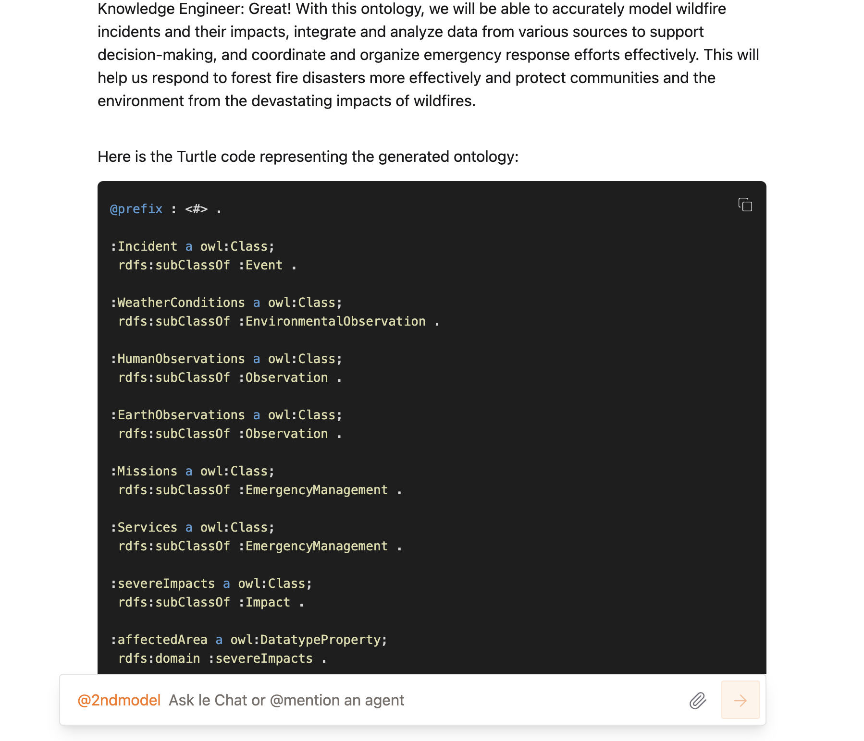
2st fine-tuning on Mistral
Second book: Semantic Web Primer
One Prompt
The generation was succesfull
Basic GPT4
Fine-tuned
GPT4

Slide 26
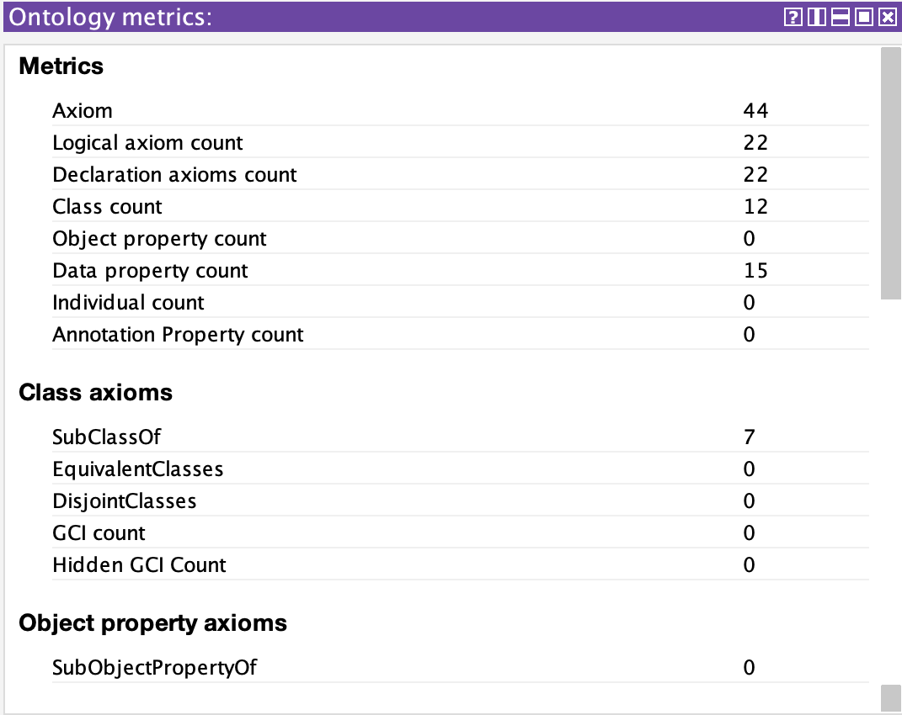
2st fine-tuning on Mistral
Basic Mistral
Fine-tuned
Mistral

Slide 27
2st fine-tuning on Mistral
METHOD | Number of Classes | True Positive | False Positives | False negatives | PRECISION | RECALL | F-1 SCORE
Reference | 80
Mistral Basic Model | 19 | 14 | 6 | 67 | 68,4% | 15,25% | 0,2626
Mistral Fine-tuned Model | 12 | 6 | 6 | 74 | 50% | 7,5% | 0,1304
METHOD | Number of Obj. properties | True Positive | False Positives | False negatives | PRECISION | RECALL | F-1 SCORE
Reference | 60
Mistral Basic Model | 17 | 4 | 13 | 56 | 23,5% | 6,66% | 0,1038
Mistral Fine-tuned Model | 0 | 0 | 0 | 0 | 0% | 0% | 0

Slide 28
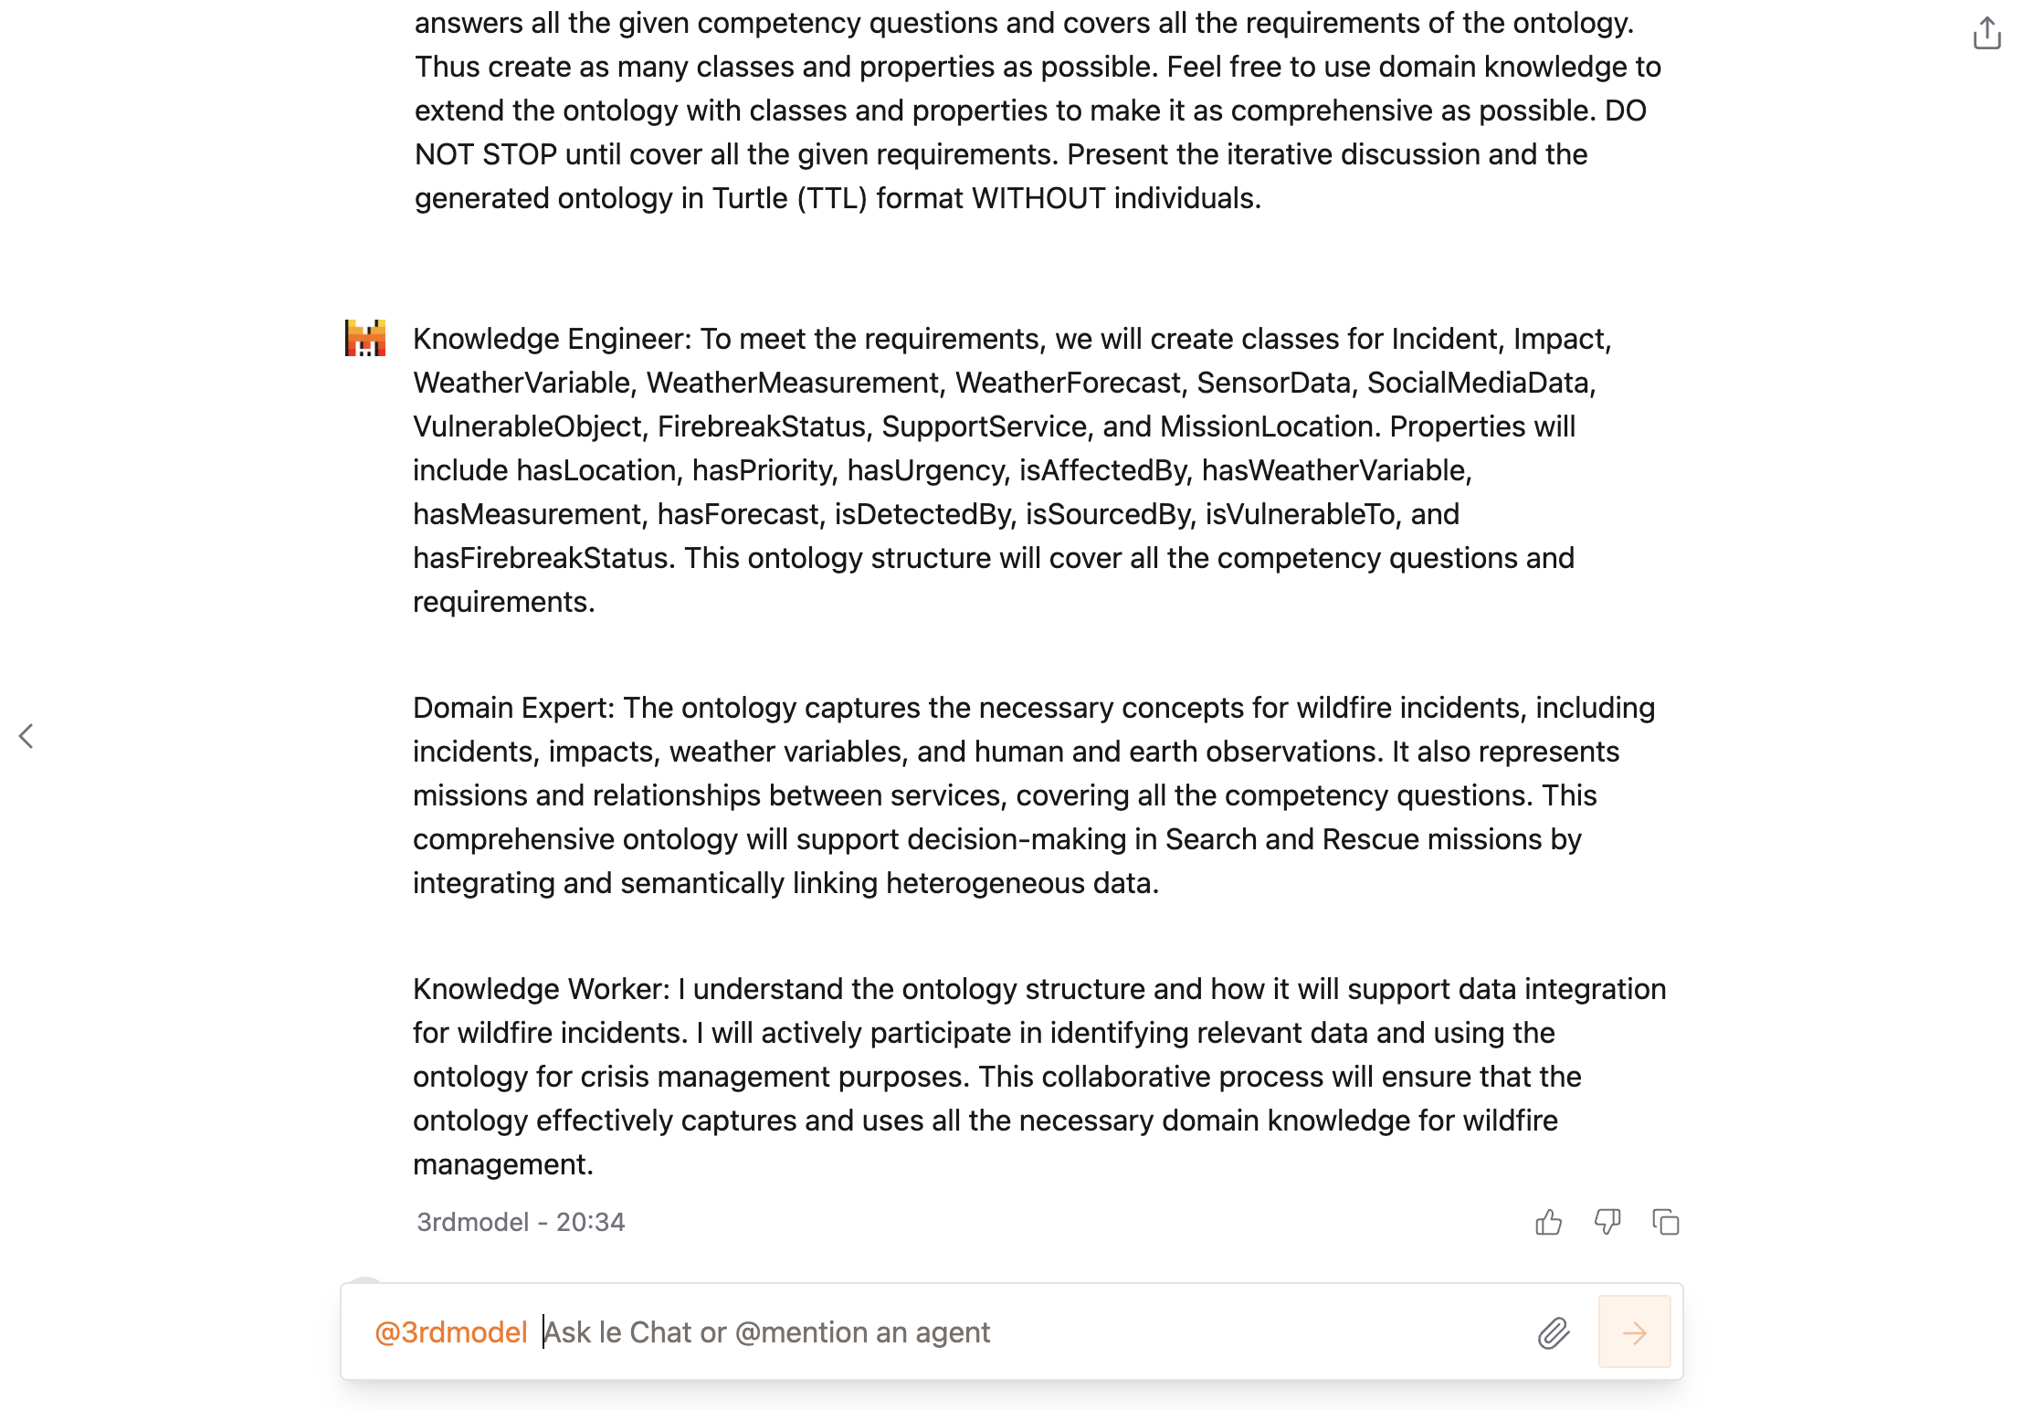
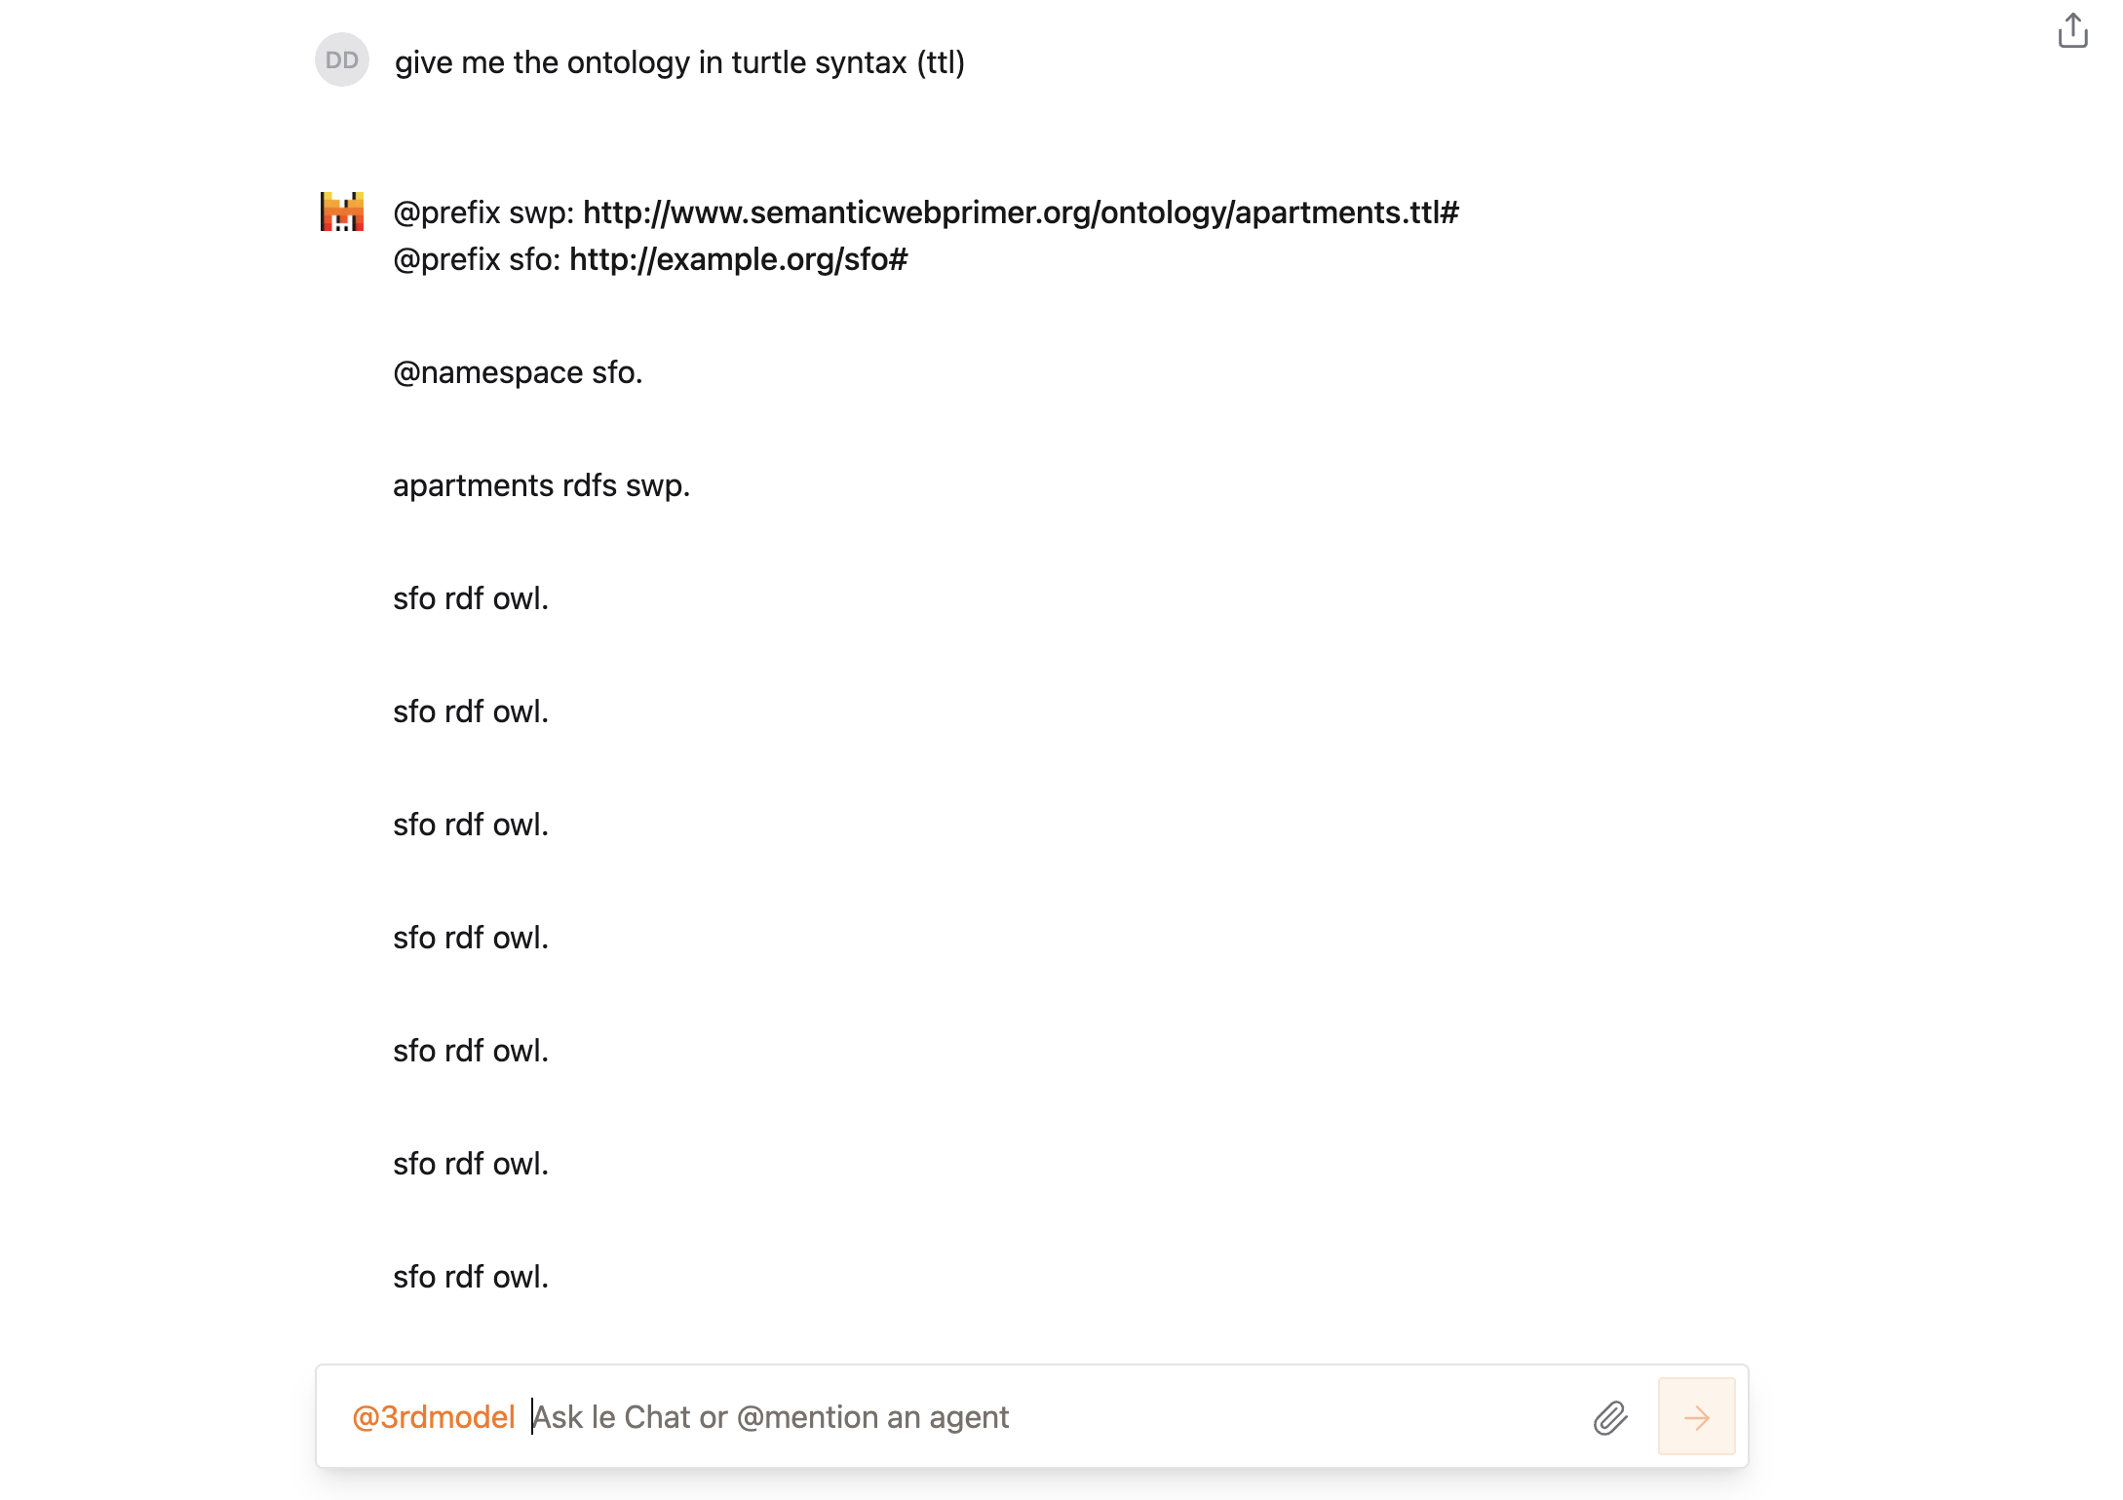
3st fine-tuning on Mistral
Second book: Ontology Engineering – Maria Keet
One Prompt
The generation was not successful, couldn’t produce the right syntax
Basic GPT4
Fine-tuned
GPT4

Slide 29
Comparison (GPT4)
METHOD | Number of Classes | True Positive | False Positives | False negatives | PRECISION | RECALL | F-1 SCORE
Reference | 80
GPT-4 Basic Model | 13 | 9 | 4 | 71 | 69% | 11,25% | 0,1935
GPT-4 Fine-tuned Model 1st | 5 | 4 | 1 | 76 | 80% | 5% | 0,0941
GPT-4 Fine-tuned Model 2nd | 12 | 10 | 2 | 70 | 83% | 12,5% | 0,2173
GPT-4 Fine-tuned Model 3rd | 16 | 13 | 3 | 67 | 81,25% | 16,25% | 0,2708
METHOD | Number of Obj. properties | True Positive | False Positives | False negatives | PRECISION | RECALL | F-1 SCORE
Reference | 60
GPT-4 Basic Model | 5 | 0 | 5 | 60 | 0% | 0% | 0
GPT-4 Fine-tuned Model 1st | 10 | 3 | 7 | 57 | 30% | 5% | 0,0857
GPT-4 Fine-tuned Model 2nd | 4 | 1 | 3 | 59 | 25% | 1,66% | 0,0312
GPT-4 Fine-tuned Model 3rd | 3 | 2 | 1 | 58 | 66,6% | 3,33% | 0,0634

Slide 30
Comparison (Mistral)
METHOD | Number of Classes | True Positive | False Positives | False negatives | PRECISION | RECALL | F-1 SCORE
Reference | 80
Mistral Basic Model | 19 | 14 | 6 | 67 | 68,4% | 15,25% | 0,2626
Mistral Fine-tuned Model 1st | 21 | 3 | 18 | 77 | 14,2% | 3,75% | 0,0594
Mistral Fine-tuned Model 2nd | 12 | 6 | 6 | 74 | 50% | 7,5% | 0,1304
Mistral Fine-tuned Model 3rd | 0 | 0 | 0 | 0 | 0% | 0% | 0
METHOD | Number of Obj. properties | True Positive | False Positives | False negatives | PRECISION | RECALL | F-1 SCORE
Reference | 60
Mistral Basic Model | 17 | 4 | 13 | 56 | 23,5% | 6,66% | 0,1038
Mistral Fine-tuned Model 1st | 4 | 0 | 4 | 60 | 0% | 0% | 0
Mistral Fine-tuned Model 2nd | 0 | 0 | 0 | 0 | 0% | 0% | 0
Mistral Fine-tuned Model 3rd | 0 | 0 | 0 | 0 | 0% | 0% | 0

Slide 31
Results-Notes-Observations
GPT4 much better performance than Mistral in terms of the generated ontologies
Mistral much cheaper and faster than GPT4 (GPT4 needed 1 hour to fine-tune the model while Mistral only 4-5 minutes)
Poor performance from both of them in general (very low F-1 Score)
Mistral failed completely on the third dataset fine-tuning, generated content without any known ontology syntax
It seems that both understood the ontology engineering project but failed on terms of domain expertise.
That probably leads to the conclusion that the model should also be trained on domain content.
Fine-tuning the GPT-4 model exclusively on ontology engineering equips it with the methodologies and principles of creating ontologies but not with the domain-specific knowledge required to apply those principles effectively in specialized areas like search and rescue in wildfire incidents.

Slide 32
Results-Notes-Observations
Incorporating domain-specific datasets is crucial:
Understanding Domain Terminology and Concepts (unique vocabulary, specific entities and relationships)
Contextual Relevance (real-world scenarios, situational nuances)
Accuracy and Completeness (avoiding misrepresentations, comprehensive Coverage)
Emulating Human Expertise
Enhancing Practical Utility (user Relevance)
-To generate a robust and close-to-human-generated ontology for search and rescue missions in wildfire incidents, it's essential to provide the model with:
Ontology Engineering Knowledge: So it knows how to structure and relate concepts.
Domain-Specific Knowledge: So it knows what concepts to include and how they interact in the real world.
-This combination enables the model to produce a rich, accurate, and useful ontology that serves the needs of practitioners in the field.

